Slide 1
Dumbways Bootcamp Devops
Week 3
Gilbran Fairuz Maulana

Slide 2
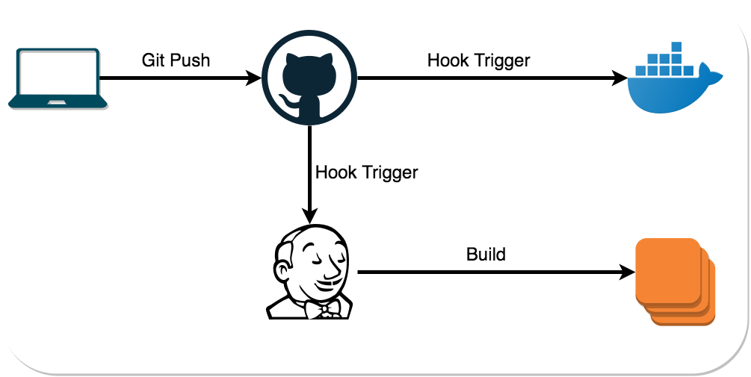

Slide 3
Task Week 3
A.
B.
C.
D.
E.
Install Docker
Create Docker Images
Install Application
Install Jenkins
Create Jenkins Job

Slide 4
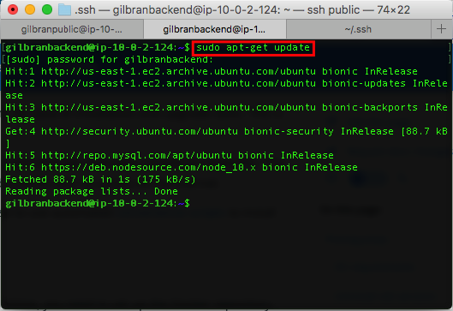
INSTALL DOCKER Backend

Slide 5
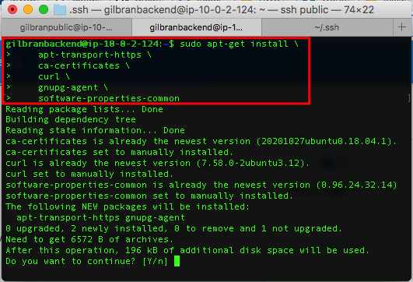
INSTALL DOCKER Backend

Slide 6
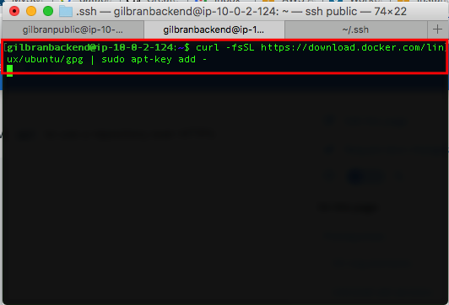
INSTALL DOCKER Backend

Slide 7
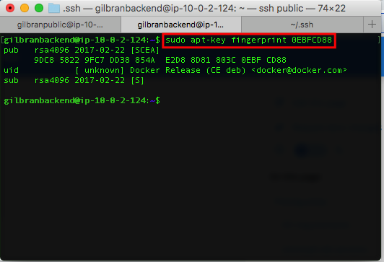
INSTALL DOCKER Backend

Slide 8
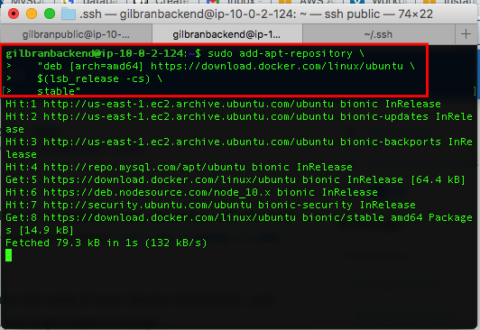
INSTALL DOCKER Backend

Slide 9
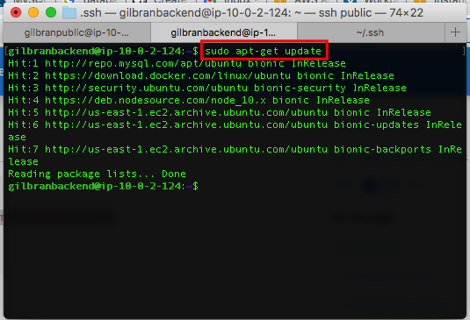
INSTALL DOCKER Backend

Slide 10
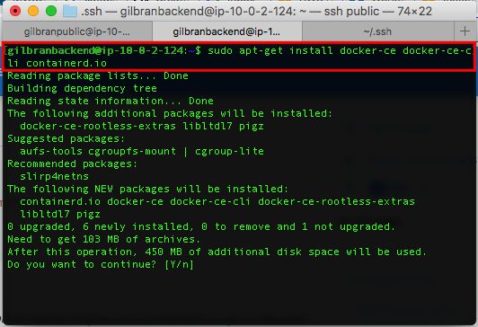
INSTALL DOCKER Backend

Slide 11
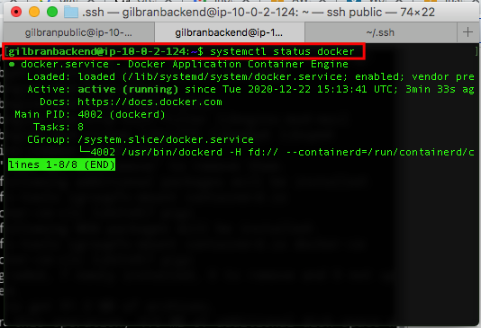
INSTALL DOCKER Backend

Slide 12
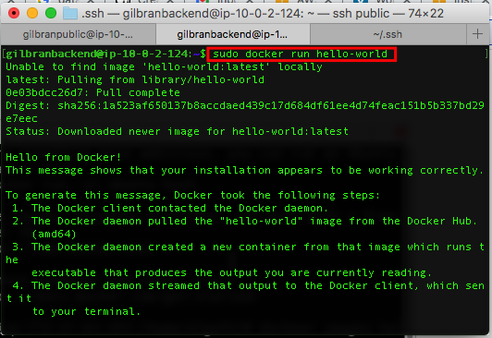
INSTALL DOCKER Backend

Slide 13
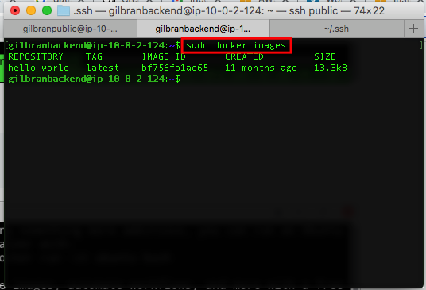
INSTALL DOCKER Backend

Slide 14
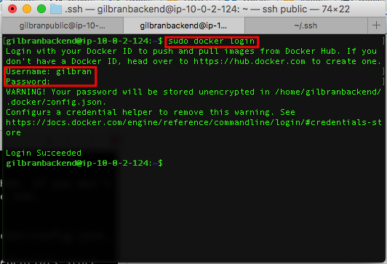
INSTALL DOCKER Backend

Slide 15
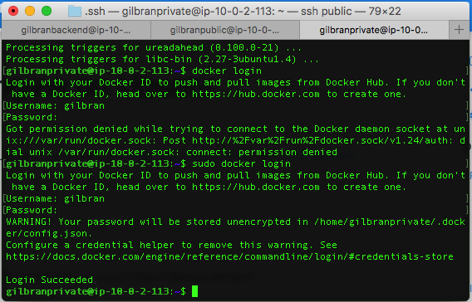
INSTALL DOCKER Frontend1

Slide 16
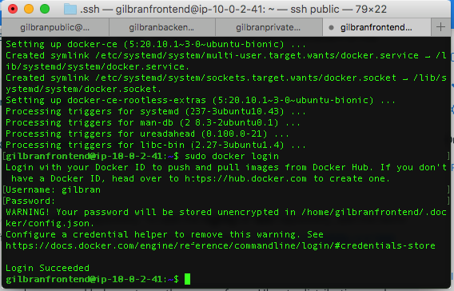
INSTALL DOCKER Frontend2

Slide 17
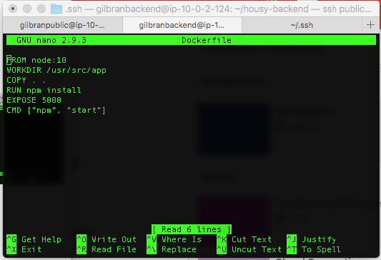
CREATE DOCKER IMAGES Backend

Slide 18
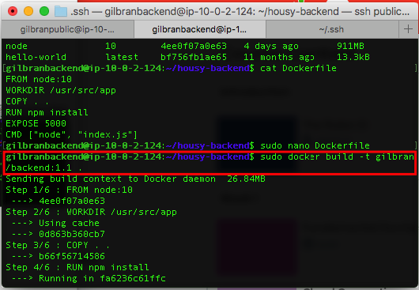
CREATE DOCKER IMAGES Backend

Slide 19
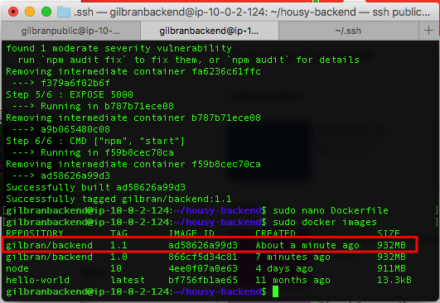
CREATE DOCKER IMAGES Backend

Slide 20
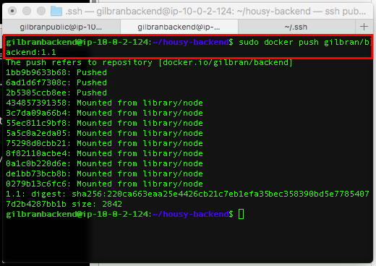
CREATE DOCKER IMAGES Backend

Slide 21
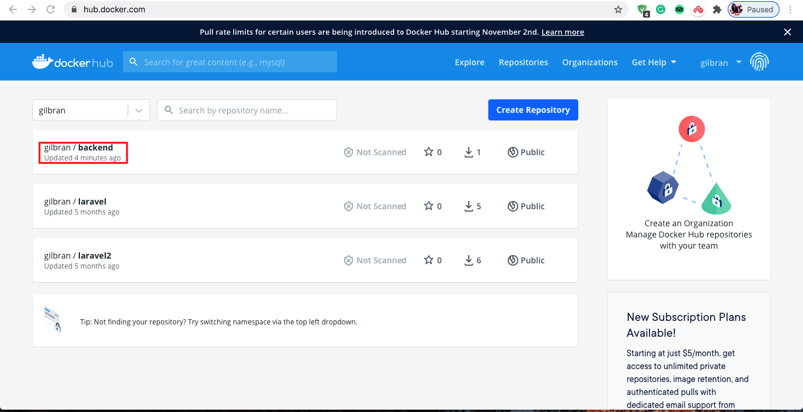
CREATE DOCKER IMAGES Backend

Slide 22
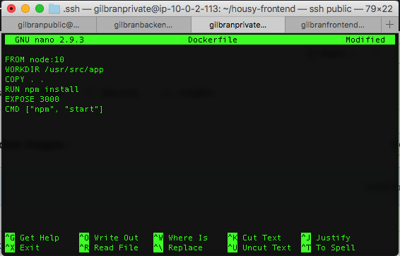
CREATE DOCKER IMAGES Frontend1

Slide 23
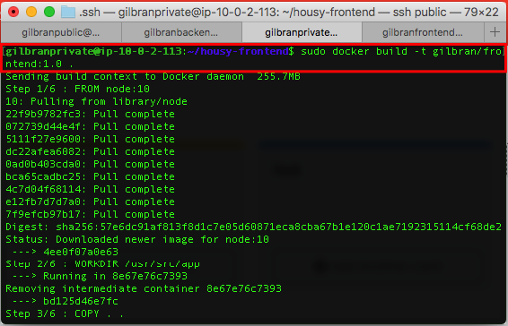
CREATE DOCKER IMAGES Frontend1

Slide 24
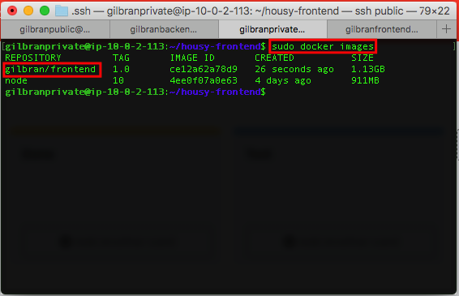
CREATE DOCKER IMAGES Frontend1

Slide 25
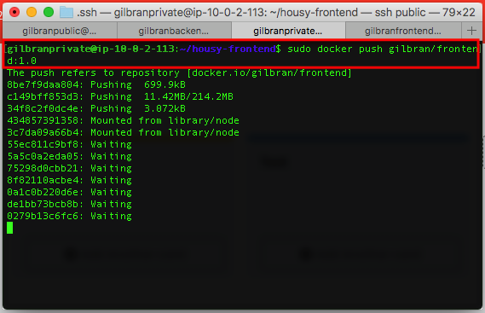
CREATE DOCKER IMAGES Frontend1

Slide 26
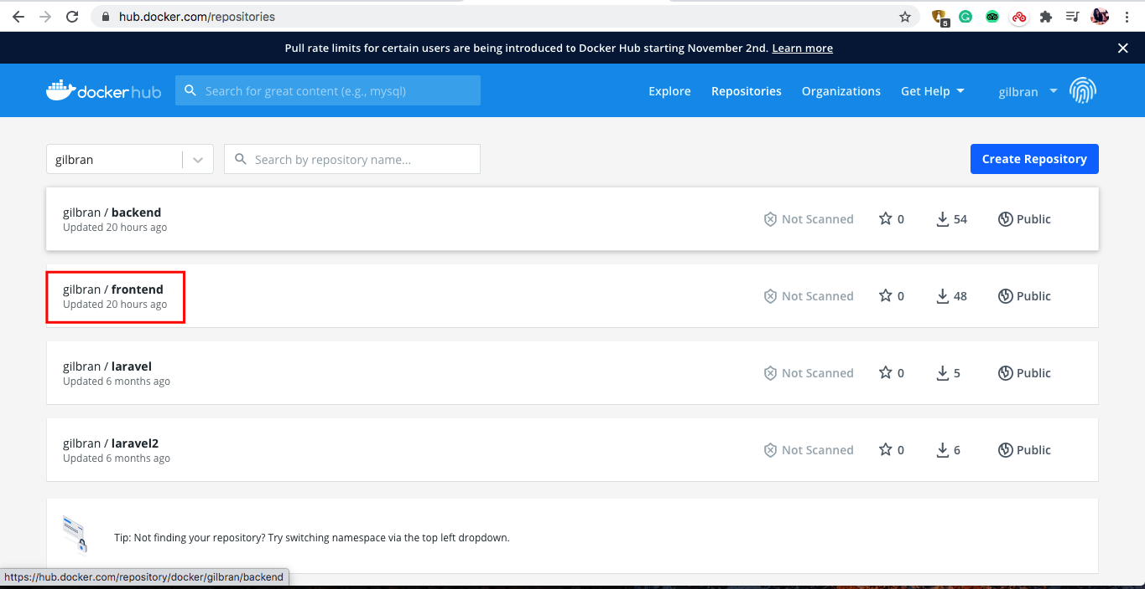
CREATE DOCKER IMAGES Frontend1

Slide 27
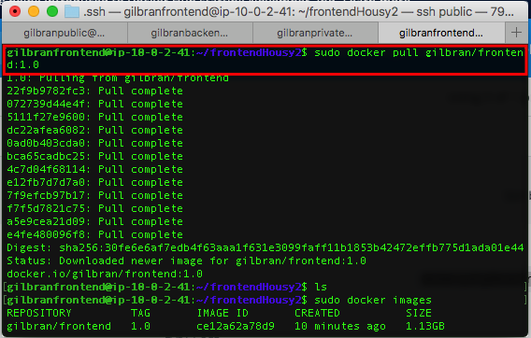
CREATE DOCKER IMAGES Frontend2

Slide 28
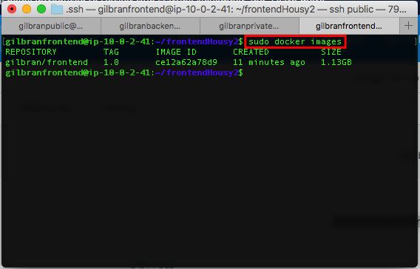
CREATE DOCKER IMAGES Frontend2

Slide 29
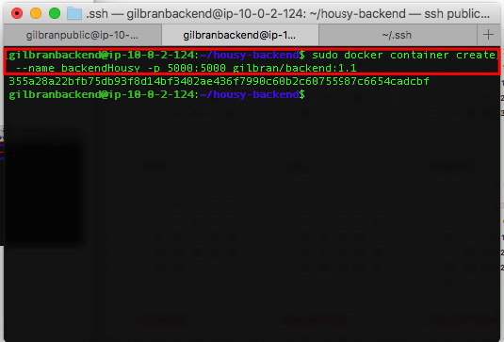
INSTALL APPLICATION Backend

Slide 30
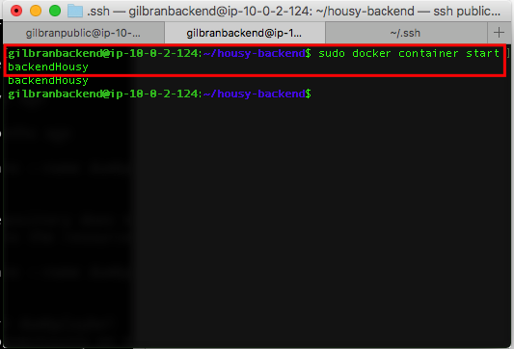
INSTALL APPLICATION Backend

Slide 31
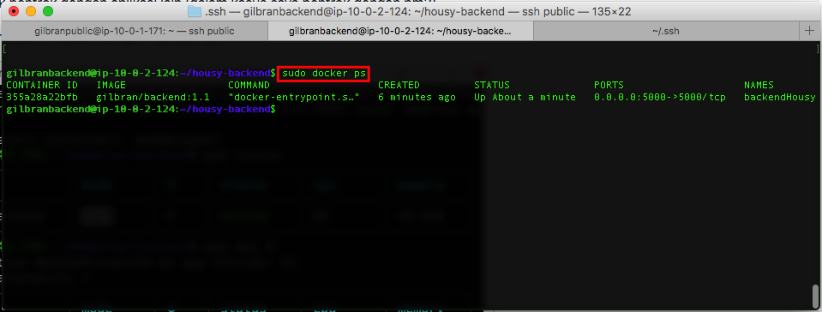
INSTALL APPLICATION Backend

Slide 32
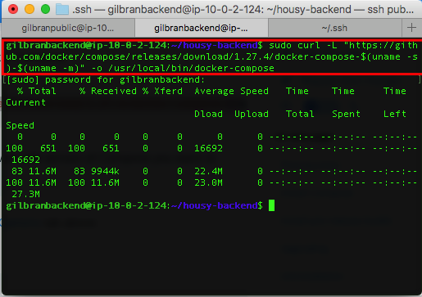
INSTALL APPLICATION Backend

Slide 33
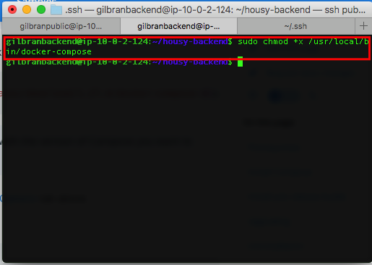
INSTALL APPLICATION Backend

Slide 34
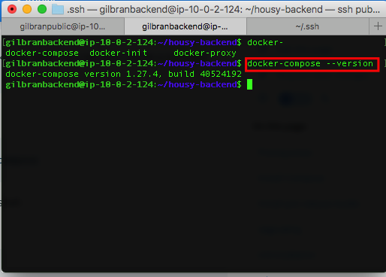
INSTALL APPLICATION Backend

Slide 35
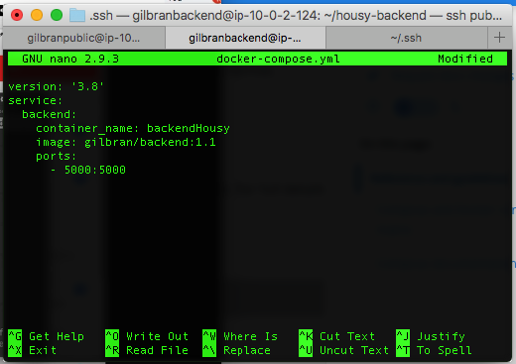
INSTALL APPLICATION Backend

Slide 36
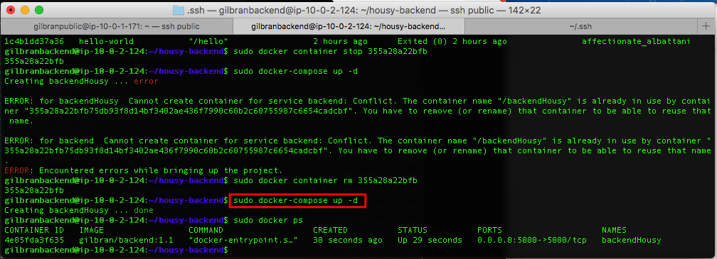
INSTALL APPLICATION Backend

Slide 37
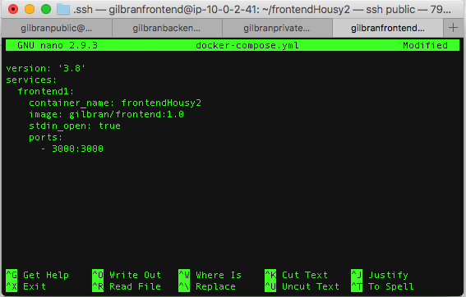
INSTALL APPLICATION Frontend2

Slide 38
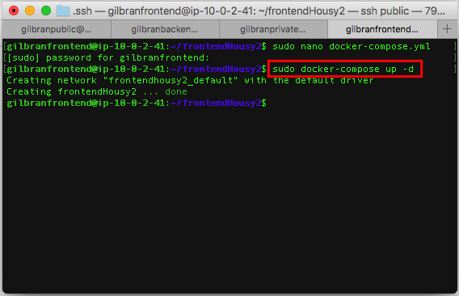
INSTALL APPLICATION Frontend2

Slide 39
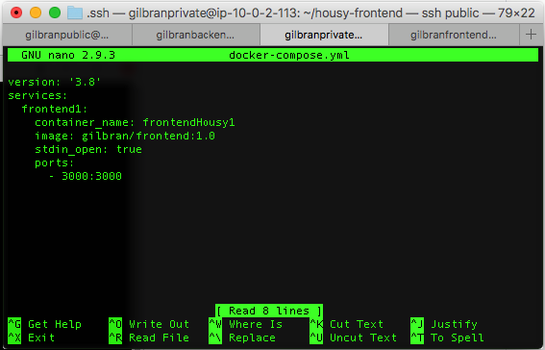
INSTALL APPLICATION Frontend1

Slide 40
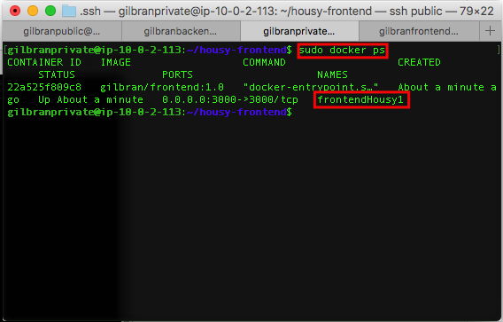
INSTALL APPLICATION Frontend1

Slide 41
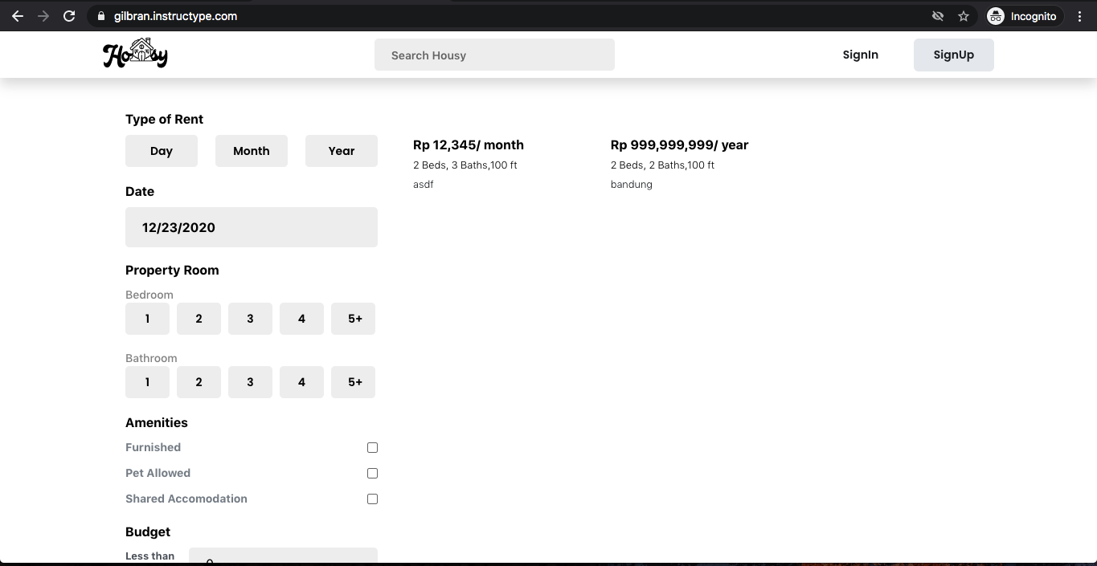
INSTALL APPLICATION Pengujian

Slide 42
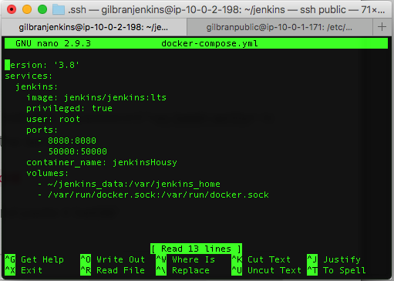
INSTALL JENKINS

Slide 43
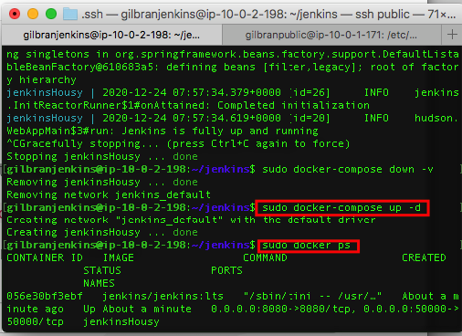
INSTALL JENKINS

Slide 44
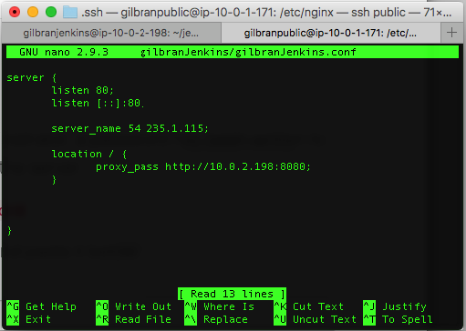
INSTALL JENKINS

Slide 45
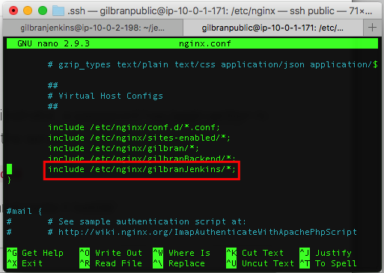
INSTALL JENKINS

Slide 46
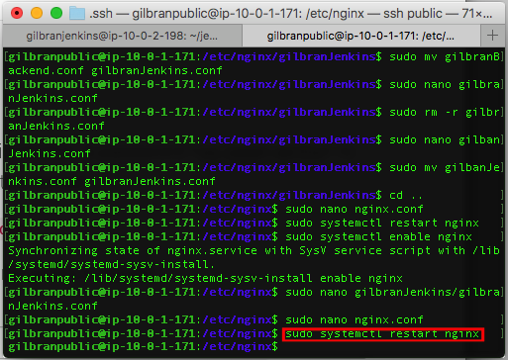
INSTALL JENKINS

Slide 47
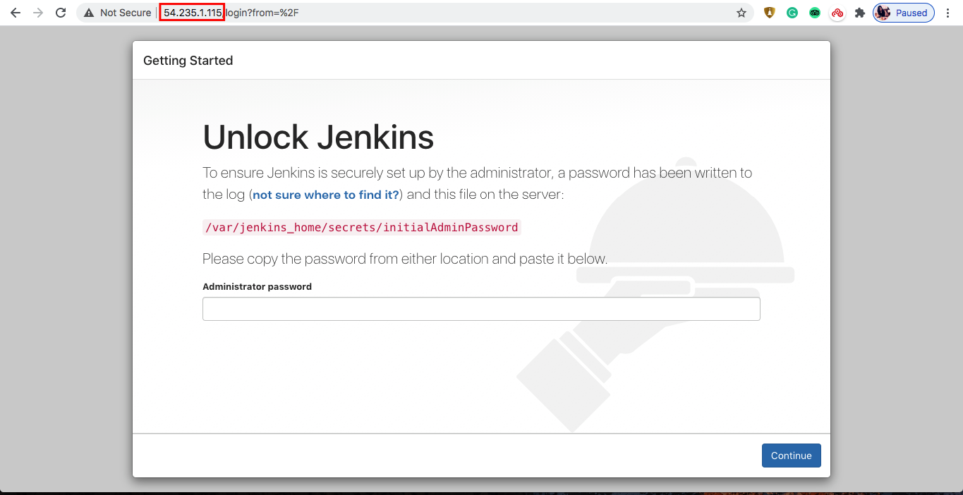
INSTALL JENKINS

Slide 48
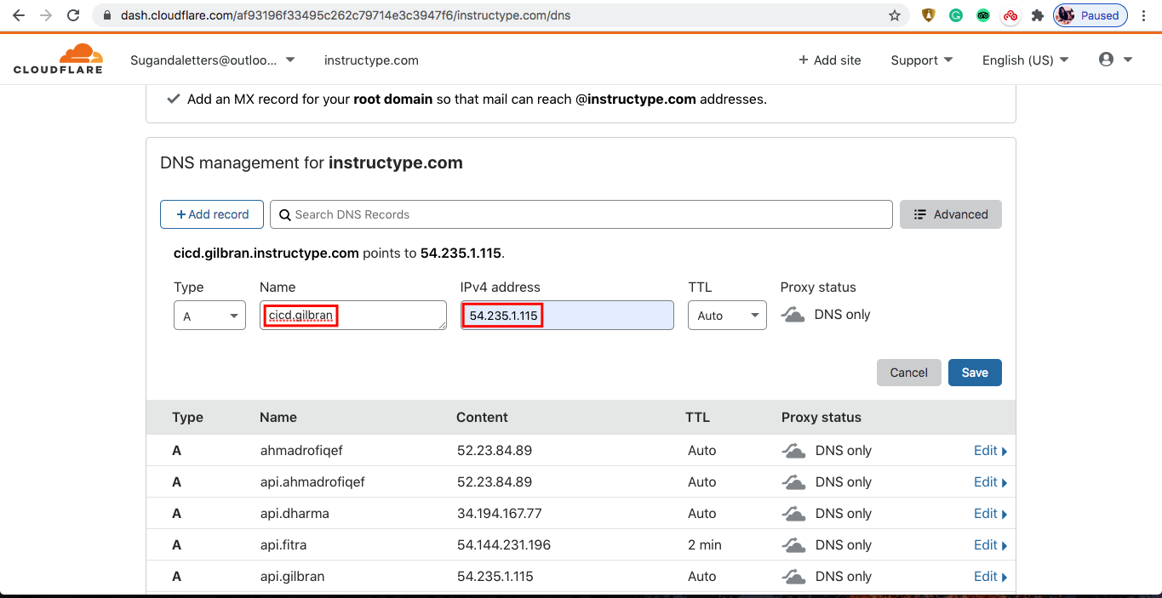
INSTALL JENKINS

Slide 49
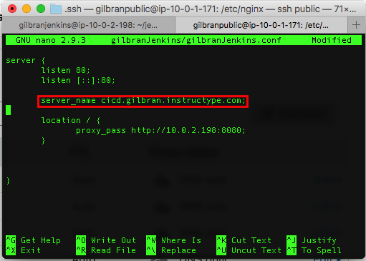
INSTALL JENKINS

Slide 50
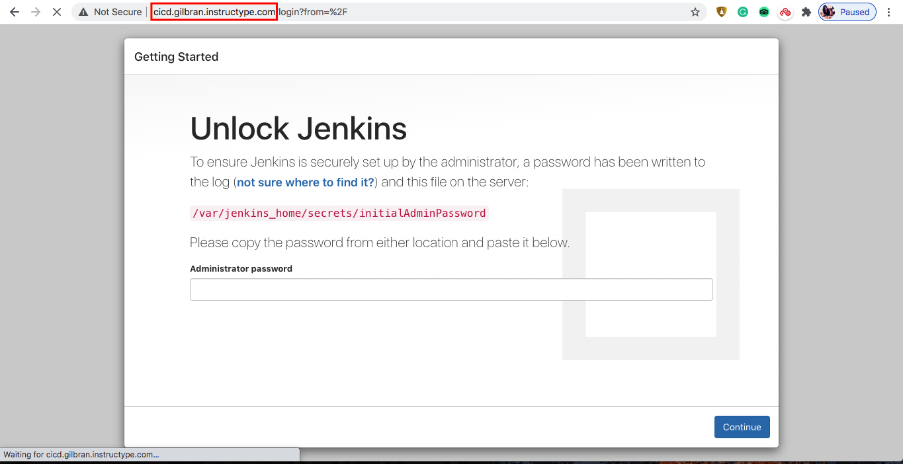
INSTALL JENKINS

Slide 51
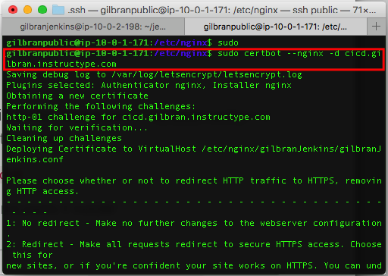
INSTALL JENKINS

Slide 52
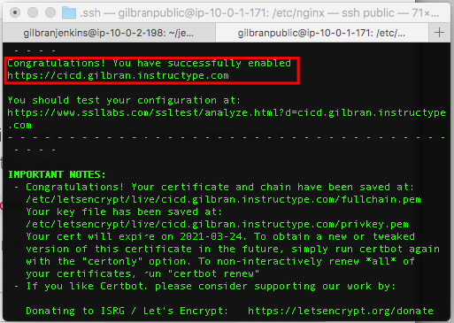
INSTALL JENKINS

Slide 53

INSTALL JENKINS

Slide 54

CREATE JENKINS JOB

Slide 55

CREATE JENKINS JOB

Slide 56

CREATE JENKINS JOB

Slide 57

CREATE JENKINS JOB

Slide 58

CREATE JENKINS JOB

Slide 59

CREATE JENKINS JOB

Slide 60

CREATE JENKINS JOB

Slide 61

CREATE JENKINS JOB

Slide 62

CREATE JENKINS JOB

Slide 63

CREATE JENKINS JOB

Slide 64

CREATE JENKINS JOB

Slide 65

CREATE JENKINS JOB EMAIL NOTIFICATION

Slide 66

CREATE JENKINS JOB EMAIL NOTIFICATION

Slide 67

CREATE JENKINS JOB EMAIL NOTIFICATION

Slide 68

CREATE JENKINS JOB EMAIL NOTIFICATION

Slide 69

CREATE JENKINS JOB EMAIL NOTIFICATION

Slide 70

CREATE JENKINS JOB EMAIL NOTIFICATION

Slide 71

CREATE JENKINS JOB EMAIL NOTIFICATION

Slide 72

CREATE JENKINS JOB EMAIL NOTIFICATION

Slide 73

CREATE JENKINS JOB EMAIL NOTIFICATION

Slide 74

CREATE JENKINS JOB EMAIL NOTIFICATION

Slide 75
THANKS!

